Slide 1
Presentation brief for MCT’s
Title of presentation | Design and Implement the serving layer
Presentation\Lab length | Presentation: 20 - 25 minutes Lab: 70 – 80 minutes
Audience | Data Engineers, Data Scientists, Data Professionals, Data Architects, BI Professionals, Developers
Purpose | Introduce the students to data warehousing schemas Teach students how Azure Data Factory/Azure Synapse Pipelines can be used to load data into the serving layer How to manage changing data in a data warehouse through slowly changing dimensions
(think) Student key takeaways | The student should understand the difference between a star and snowflake schema The student should understand how the mapping data flow can transform and load data into the serving layer The student should be able to manage a slowly changing dimension (SCD) using ADF/Synapse Pipelines
(feel) Student desired mindset | The student may feel that they may not be involved in defining schema The student may never have created a data warehouse schema before so they feel this is new The student may feel that they were not aware that ADF/Synapse Pipeline could manage SCD’s
(do) Student outcomes | The student should be able to create a star and snowflake schema in Azure Synapse Analytics The student should be able to load data into a serving layer in Azure Synapse Analytics The students should be able to understand how to manage slowly changing dimensions
More information | For MCT course feedback, visit the Microsoft Official Courseware forum
Notes:
Instructor notes and guidance.
This slide is for MCT use only, outlining the aims and objectives of this module.

Slide 2
DP-203T00: Design and implement the serving layer
Notes:
Instructor notes and guidance.
This module goes into a lot of dimensional design theory with a lab that gives the students the hands-on aspects that cements the theory into reality. And all of this is done with a comparison of creating a data warehouse in a symmetrical multiple processing (SMP) system such as SQL Server and comparing it to creating a data warehouse in a massively parallel processing (MPP) that is available with a dedicated SQL pool in Azure Synapse Analytics.
Before that though, it is important to ensure that the student understands the notion of dimension design, and that they understand the role of a fact table versus a dimension table, and how this relates to the notion of star schema and snowflake schema. This is critical as the lab covers the creation of these objects, and the methods you can load data into them. This work is done in both SQL Database and Azure Synapse Analytics for comparison only, to make the distinction that you have to be aware of these differences when using Azure Synapse Analytics.
They will then get their first exposure to Azure Data Factory/Azure Synapse Pipelines using the mapping data flow to manage a dimension table that implements slowly changing dimension (SCD) type 1. Tell the students that they will be covering ADF/Synapse pipelines in depth in later modules, and that this is an example of how it can be used to work with a very common data warehouse pattern; managing SCD’s

Slide 3
Agenda
Lesson 01: Design a multidimensional schema to optimize analytical workloads
Lesson 02: Perform code-free transformation at scale with Azure Data Factory or Azure Synapse Pipelines
Lesson 03: Populate slowly changing dimensions in Azure Synapse Analytics pipelines
Notes:
Instructor notes and guidance.
This space has been left deliberately blank

Slide 4
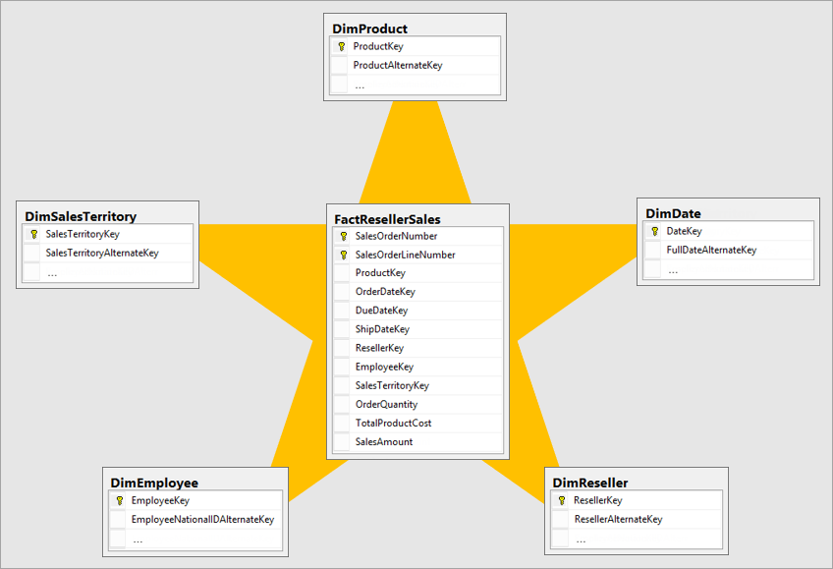
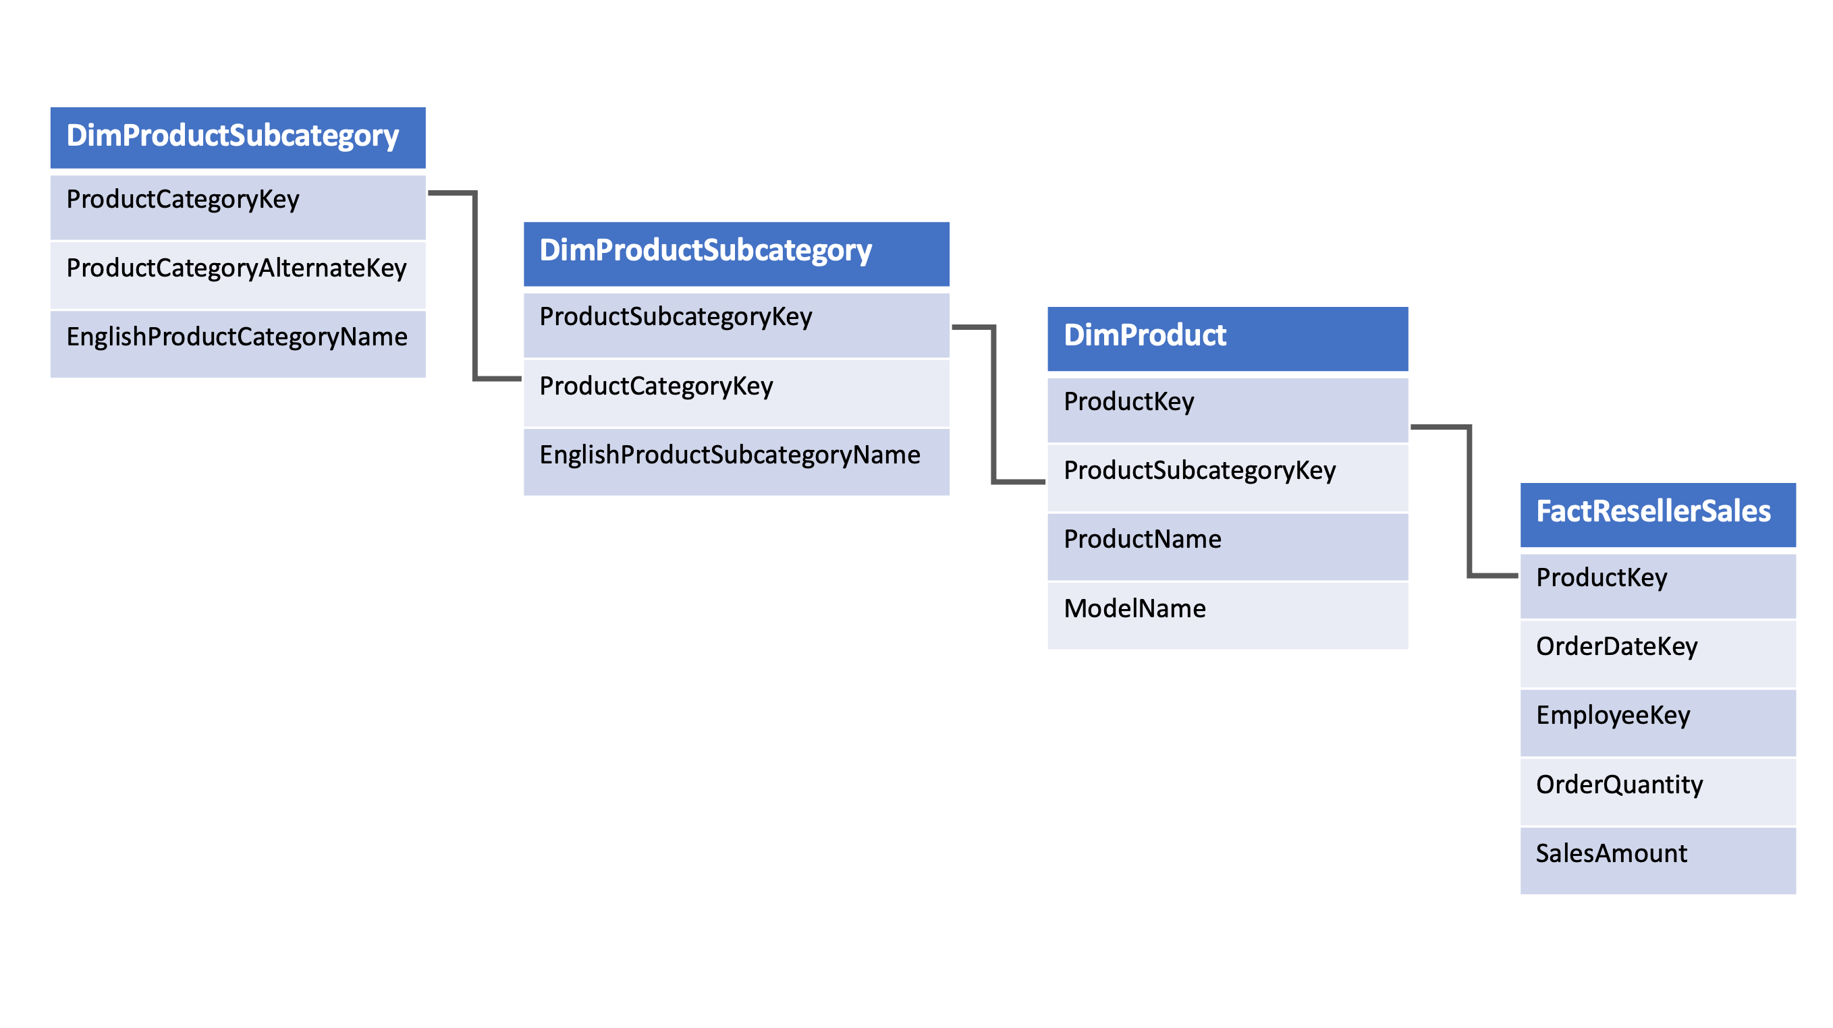
Design a multidimensional schema to optimize analytical workloads
Notes:
Talking points
Ensure that the students understand the distinction between a fact table and a dimension table. Also call out to the students that it is not uncommon to have multiple fact tables within a single data warehouse to answer a range of business questions.
Once established, then follow up with the snowflake schema and its aim to normalize the data to reduce the repetition in the data and therefore the space taken up by the data, leading to less IO requests making it quicker to retrieve the data in queries.
Call out the reality that typical data warehouse solutions have a hybrid of the two schema to fulfill analytical requirements.
Instructor notes and guidance.
This slide is a build slide
Click 1 – brings in the star schema graphic
Click 2 – the star schema graphic disappears
Click 3 – the snowflake schema graphic appears
Recommended reading for this slide
Design a multidimensional schema to optimize analytical workloads - Learn | Microsoft Docs

Slide 5
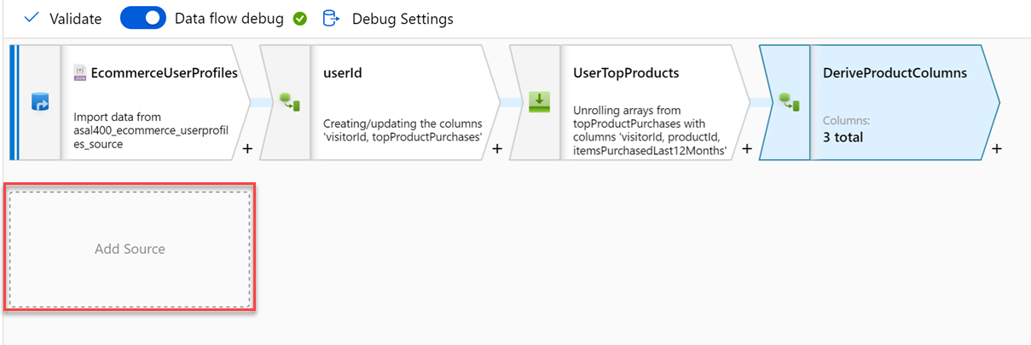
Code-free transformation at scale with Azure Data Factory or Azure Synapse Pipelines
Notes:
Talking points
Let’s dive into the data flow mapping
Mapping data flows are visually designed data transformations in Azure Data Factory or Azure Synapse Pipelines.
Data flows allow data engineers to develop graphical data transformation logic without writing code.
The resulting data flows are executed as activities within Azure Data Factory/Synapse pipelines that use scaled-out Spark clusters.
Data flow activities can be operationalized via existing Data Factory/Synapse Pipeline scheduling, control, flow, and monitoring capabilities. Mapping data flows provide a fully visual experience with no coding required.
Your data flows will run on your own execution cluster for scaled-out data processing. Azure Data Factory/Synapse handles all the code translation, path optimization, and execution of your data flow jobs.
Data Flow mapping brings the following benefits and capabilities:
- Perform data cleansing, transformation, aggregations, etc.
- Enables you to build resilient data flows in a code free environment
- Enable you to focus on building business logic and data transformation
- The underlying infrastructure is provisioned automatically with cloud scale via Spark execution
Like many data transformation tools, Mapping Data Flow in Azure Data factory supports a great variety of data transformations.
Instructor notes and guidance.
Note that this content is valid for both Azure Data Factory and Azure Synapse Pipelines. Consider showing an example through a demo, you should consider replaying some of the activities done in the lab. The feedback from MCTs about DP200 is that many students needed help the ADF lab, so replaying the mapping data flow should be considered.
Recommended reading for this slide
Code-free transformation at scale with Azure Data Factory - Learn | Microsoft Docs

Slide 6
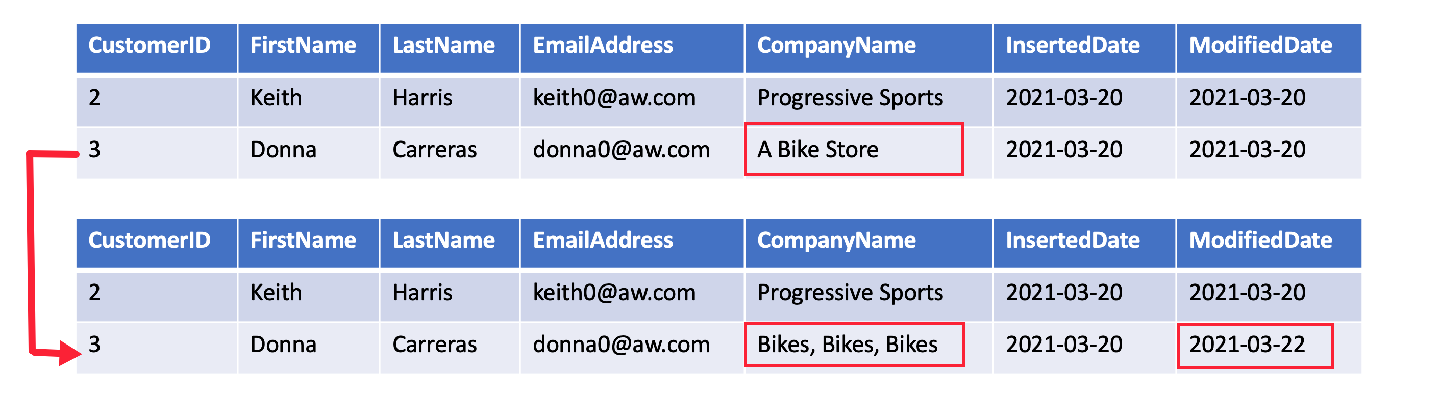
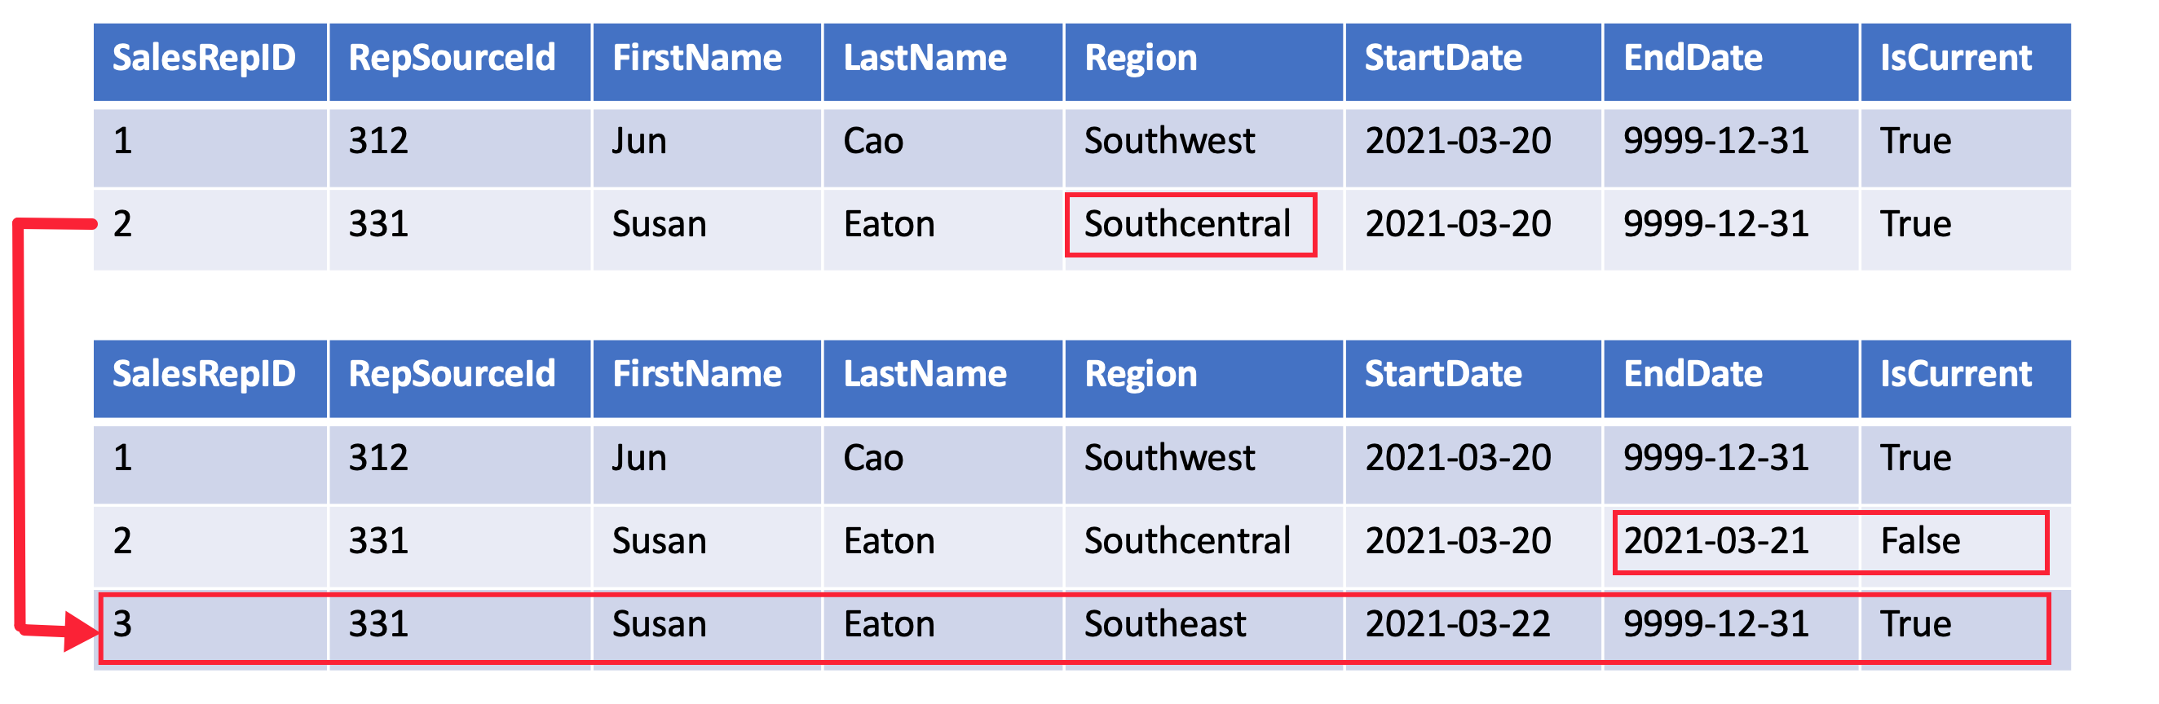
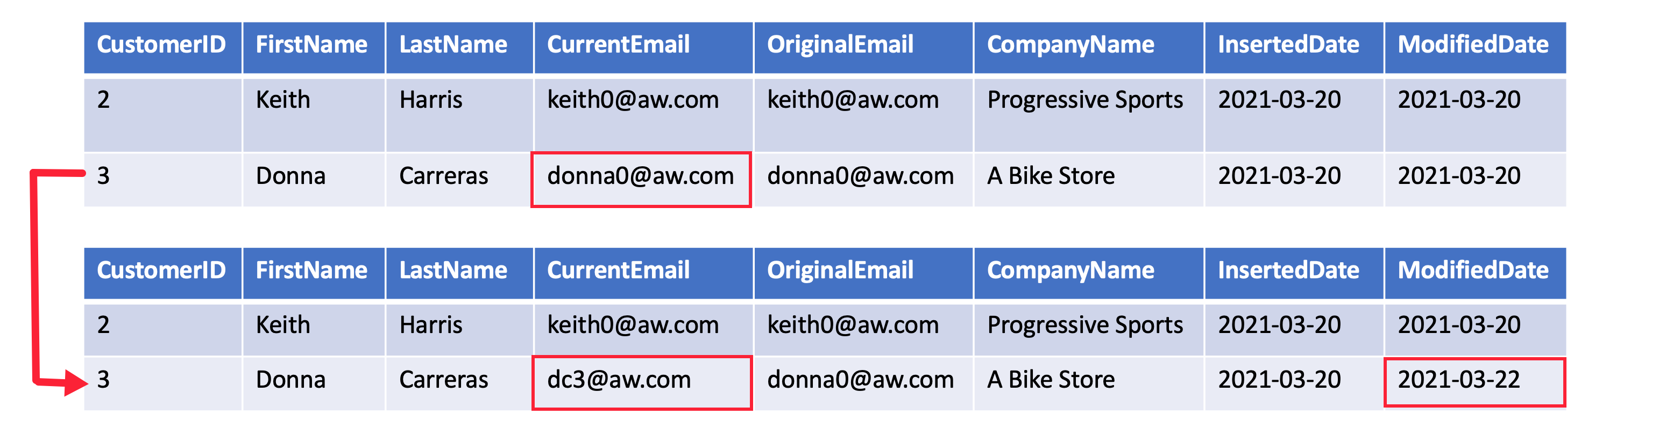
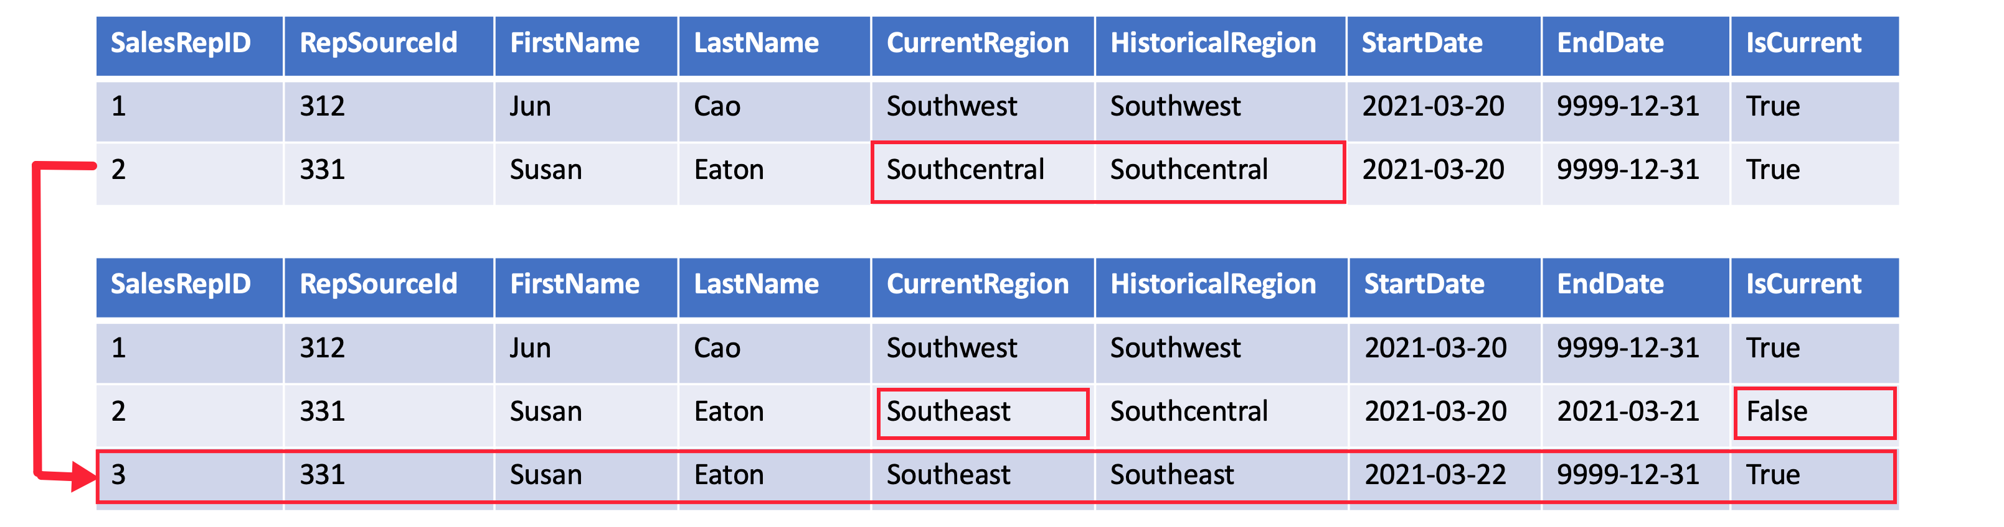
Populate slowly changing dimensions in Azure Synapse Analytics pipelines
SCD Type 1
SCD Type 2
SCD Type 3
SCD Type 6
Notes:
Talking points
A Type 1 SCD always reflects the latest values, and when changes in source data are detected, the dimension table data is overwritten.
A **Type 2 SCD** supports versioning of dimension members. The dimension table must use a surrogate key to provide a unique reference to a version of the dimension member. It also includes columns that define the date range validity of the version (for example, `StartDate` and `EndDate`) and possibly a flag column (for example, `IsCurrent`) to easily filter by current dimension members.
A **Type 3 SCD** supports storing two versions of a dimension member as separate columns. The table includes a column for the current value of a member plus either the original or previous value of the member. So Type 3 uses additional columns to track one key instance of history, rather than storing additional rows to track each change like in a Type 2 SCD.
A **Type 6 SCD** combines Type 1, 2, and 3. When a change happens to a Type 2 member you create a new row with appropriate StartDate and EndDate. In Type 6 design you also store the current value in all versions of that entity so you can easily report on the current value or the historical value.
Instructor notes and guidance.
This slide is a build slide
Click 1 – brings in the SCD type 1 graphic
Click 2 – removes the SCD type 1 graphic
Click 3 – brings in the SCD type 2 graphic
Click 4 – removes the SCD type 2 graphic
Click 5 – brings in the SCD type 3 graphic
Click 6 – removes the SCD type 3 graphic
Click 7 – brings in the SCD type 6 graphic
Click 8 – removes the SCD type 6 graphic
Recommended reading for this slide
Populate slowly changing dimensions in Azure Synapse Analytics pipelines - Learn | Microsoft Docs

Slide 7
Review questions
Q01 – Which table keeps a record of an event that has occurred in the business?
A01 – A fact table
Q02 – Which SCD type would you use to keep history of changes in dimension members by adding a new row to the table for each change?
A02 – Type 2 SCD
Q03 – Which SCD type would you use to update the dimension members without keeping track of history?
A03 – Type 1 SCD
Notes:
Instructor notes and guidance.
This space has been left deliberately blank

Slide 8
Lab: Design and Implement the serving layer
Notes:
Instructor notes and guidance.
This space has been left deliberately blank

Slide 9
Lab overview
This lab teaches how to design and implement data stores in a modern data warehouse to optimize analytical workloads. The student will learn how to design a multidimensional schema to store fact and dimension data. Then the student will learn how to populate slowly changing dimensions through incremental data loading from Azure Data Factory.
Lab objectives
After completing this lab, you will be able to:
Design a multidimensional schema to optimize analytical workloads
Perform code-free transformation at scale with Azure Data Factory
Populate slowly changing dimensions in Azure Synapse Analytics pipelines
Notes:
Instructor notes and guidance.
The work in exercise 1, 2 and 3 is performed in SQL Database
In exercise 1, the students will create a star schema in SQL database, using foreign key constraints. In exercise 2, the students create a snowflake schema in SQL database. In exercise 3, the student will explore a common way for managing a common dimension. The time dimension.
The reason for working with SQL Database, is to reinforce the contrast with how you work with Azure Synapse Analytics. As it is an Massively Parallel Processing (MPP) system, you must work differently in creating data warehouses, then you would with an Symmetrical Processing System (SMP) system such as SQL Database.
In exercise 4, the students create a star schema in Azure Synapse Analytics. You may notice some differences with creating tables in Synapse Analytics vs. SQL database, but the same data modelling principles apply. When you create a star schema or snowflake schema in Azure Synapse Analytics, it requires some changes to your table creation scripts. In Azure Synapse, you do not have foreign keys and unique value constraints like you do in SQL Server. Since these rules are not enforced at the database layer, the jobs used to load data are more responsible to maintain data integrity. You still have the option to use clustered indexes, but for most dimension tables in Azure Synapse you will benefit from using a clustered columnstore index (CCI). This exercise reinforces this important distinction.
In exercise 5, the student will learn how they can update a dimension table by loading data into a dimension table using Azure Synapse pipelines.

Slide 10


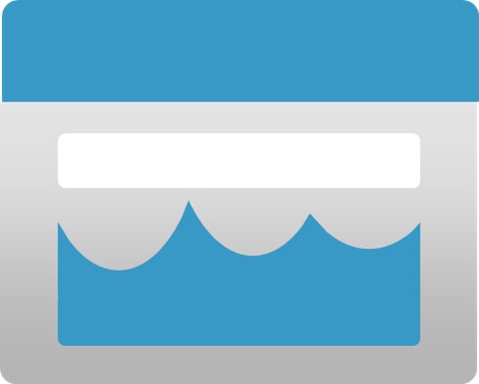








Lab 02 Overview
asacosmosdb<unique_suffix>
CosmosDB
Campaign Info
Azure Databricks
asagadatalake<unique_suffix>
Cluster
Azure Data Lake
wwi-02
Sales (parquet)
Customer (csv)
dp203sql<unique_suffix>
SourceDB
Synapse Analytics
Dedicated SQL Pool (SQLPool1)
Built-In Serverless SQL Pool
Apache Spark pool
Pipelines and Dataflows
Power BI
asagaworkspace<unique_suffix>
Notes:
This slide is an optional slide that you can use to show a high-level overview of the technologies used in the lab.
This lab teaches how to design and implement data stores in a modern data warehouse to optimize analytical workloads. The student will learn how to design a multidimensional schema to store fact and dimension data. Then the student will learn how to populate slowly changing dimensions through incremental data loading from Azure Data Factory.

Slide 11
Lab review
Question 1 – Can you enable foreign keys and unique value constraints to maintain data integrity in Azure Synapse Analytics?
Question 2 – What type of table distribution is used on Fact tables stored in a dedicated SQL pool in Azure Synapse Analytics?
Question 3 – In what scenario would a hash distributed table on a fact table also benefit from having a cluster columnstore index being created too?
Question 4 – In a mapping data flow, what is the benefit of creating a SHA256 hash of the table values?
Notes:
Answers
Question 1 – At this time no. As a result the referential integrity must be checked as you load data into the system
Question 2 – a hash-distribution
Question 3 – when two hash tables are joined on the same distribution column.
Question 4 - We use this to detect row changes by comparing the hash of the incoming records to the hash value of the destination records, matched by the same ID between source and destination

Slide 12
Module summary
In this module, you have learned about:
Design a multidimensional schema to optimize analytical workloads
Perform code-free transformation at scale with Azure Data Factory
Populate slowly changing dimensions in Azure Synapse Analytics pipelines
Next steps
After the course, consider exploring any data warehouses that exist within your organization. Are you able to identify any new areas as a result of what you have learned in this module? Find examples of slowly changing dimensions and what type of SCD’s the tables are
Notes:
Instructor notes and guidance.
The next steps is suggested post course learning materials to reinforce what they have learned in the module.

Slide 13
Closing slide
Notes:
Instructor notes
This space has been left deliberately blank

